Slide 1
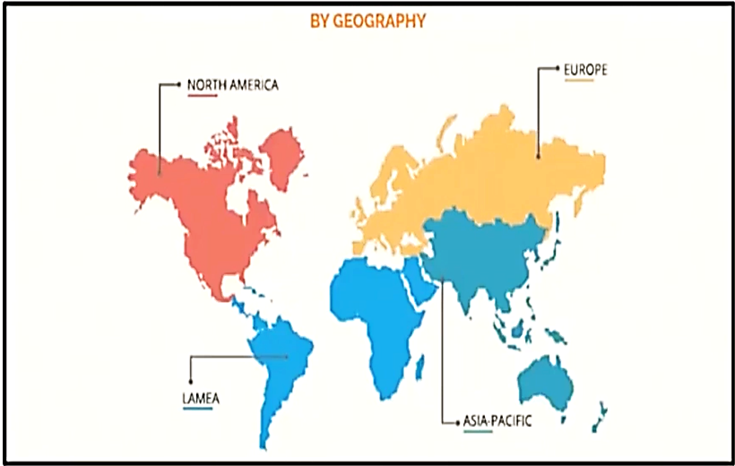
Global EV Market

Slide 2
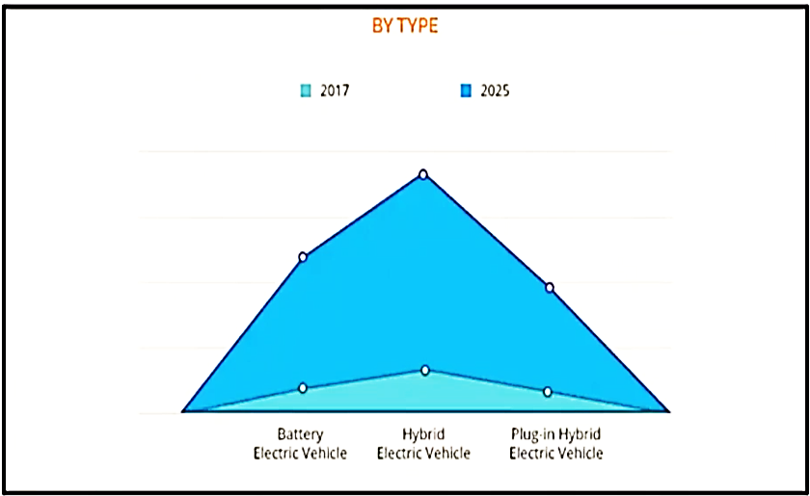
Global EV Market

Slide 3
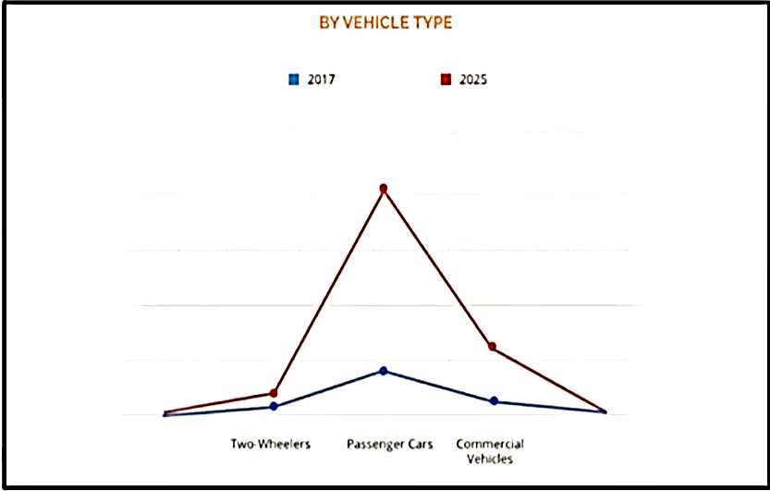
Global EV Market

Slide 4
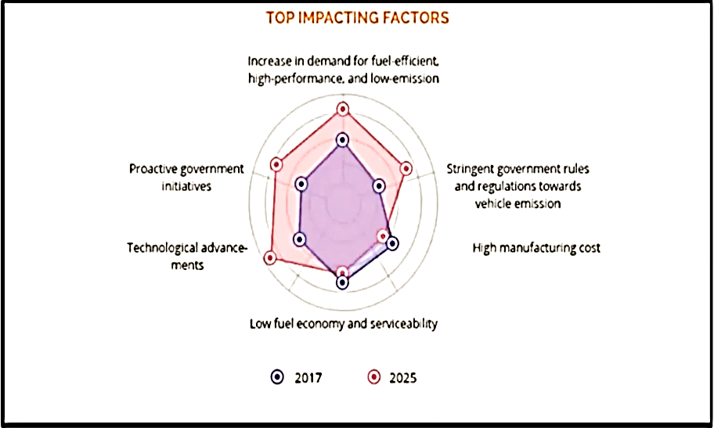
Global EV Market

Slide 5
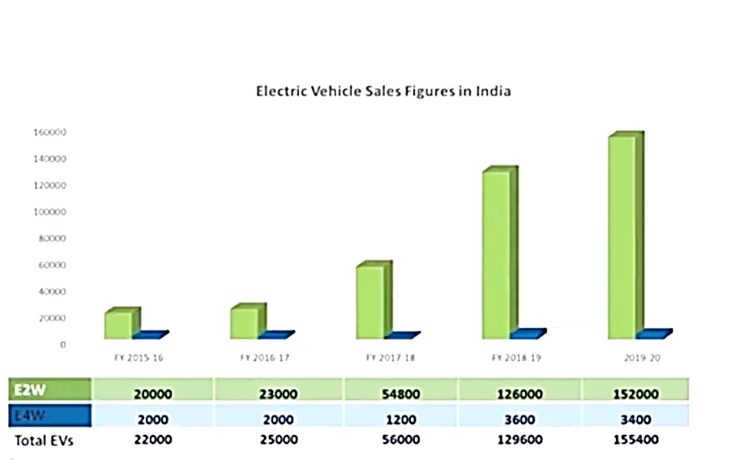
Indian EV Market

Slide 6
Indian EV Market
Electric Vehicles sales in india
 | FY2021 | FY2020 | % growth
2Ws | 1,43,837 | 1.52,000 | -5.37%
3Ws | 88,378 | 1,40,683 | -37%
Cars | 5,905 | 2,814 | 110%
Total EVs | 2,38,120 | 2,95,497 | -19%

